Slide 1

MAY 4, 2020
DEEP STOCK PREDICTIONS
Maximizing profits by using predicted stock prices to switch stock holding positions
AKASH DOSHI, ALEXANDER ISSA, PUNEET SACHDEVA, SINA RAFATI, SOMNATH RAKSHIT
Students (EE380), The University of Texas at Austin

Slide 2
Introduction
Stock markets are conduit of financial resources connecting entrepreneurs and investors.
Market Intermediaries are short term traders who carry out high frequency trades and provide liquidity to Stock Markets
We advocate increasing usage of machine learning by intermediaries to maximize short term gains
We design a range of LSTM architectures and loss functions, and supply its predictions to a trading bot that performs portfolio optimization daily to maximize the net worth.
Notes:
This one needs to be rewritten

Slide 3
Objectives
Perform daily stock price prediction using
ARIMA
Multi-Stack LSTM with mean squared error as the loss function.
Multi-Stack LSTM with a customized loss function
Correlated indicators added to a Multi-Stack LSTM with Attention
Finally perform a data driven optimization of LSTM hyperparameters to identify the best prediction model

Slide 4
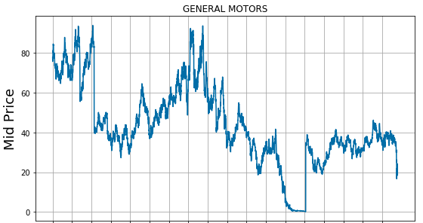
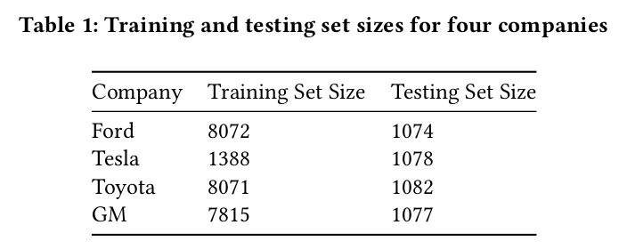
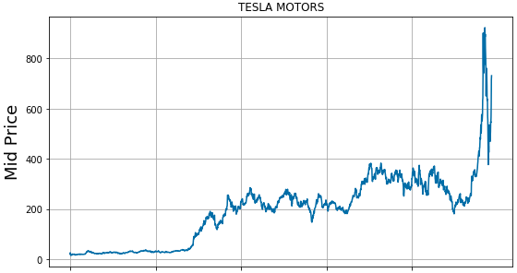
Dataset & Data Pre-processing
Stock Price data for 4 companies : Ford(1983 to 2020), GM (1985 to 2020), Toyota ( 1980 - 2020) and Tesla (2010 -2020): from Capital IQ Database by Compustat
Used the Mid price computed as a daily average of the High and Low price.
The training data is scaled using Standard Scaler.
Databases access using Wharton WRDS subscription at the University of Texas at Austin
Notes:
Alternated between optimizing our model and pre-processing data

Slide 5
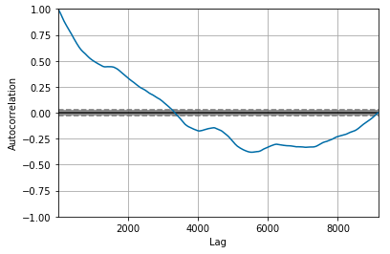
ARIMA
AutoRegressive Integrated Moving Average
Used for modelling time-series data. It was made to be “stationary” by differencing
Order of differencing is estimated using auto-correlation
It is a regression based on predictors consisting of the lags of dependent variables
p: number of autoregressive terms d: number of non-seasonal differences
q: number of lagged forecast errors in the prediction equation

Slide 6
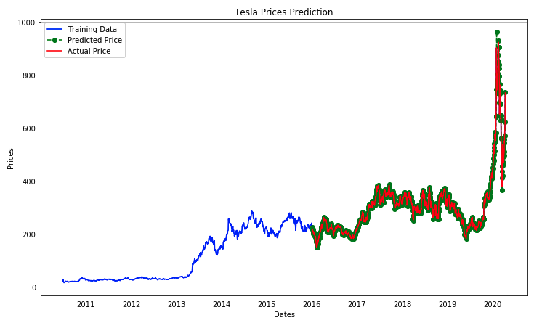
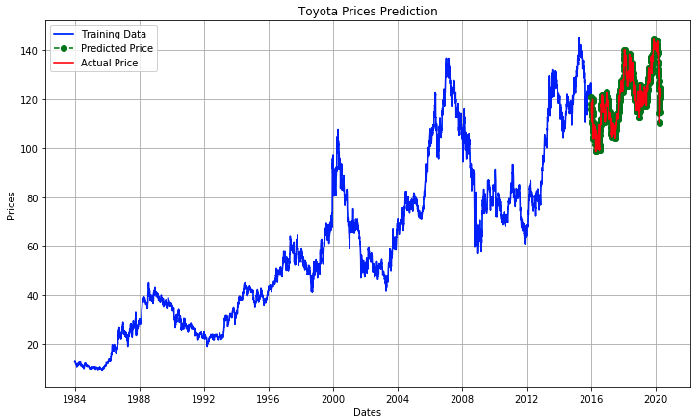
ARIMA Results
Derived new features: mean and standard deviation of lagged values by looking at 3 days, 7 days, and 30 days back.

Slide 7
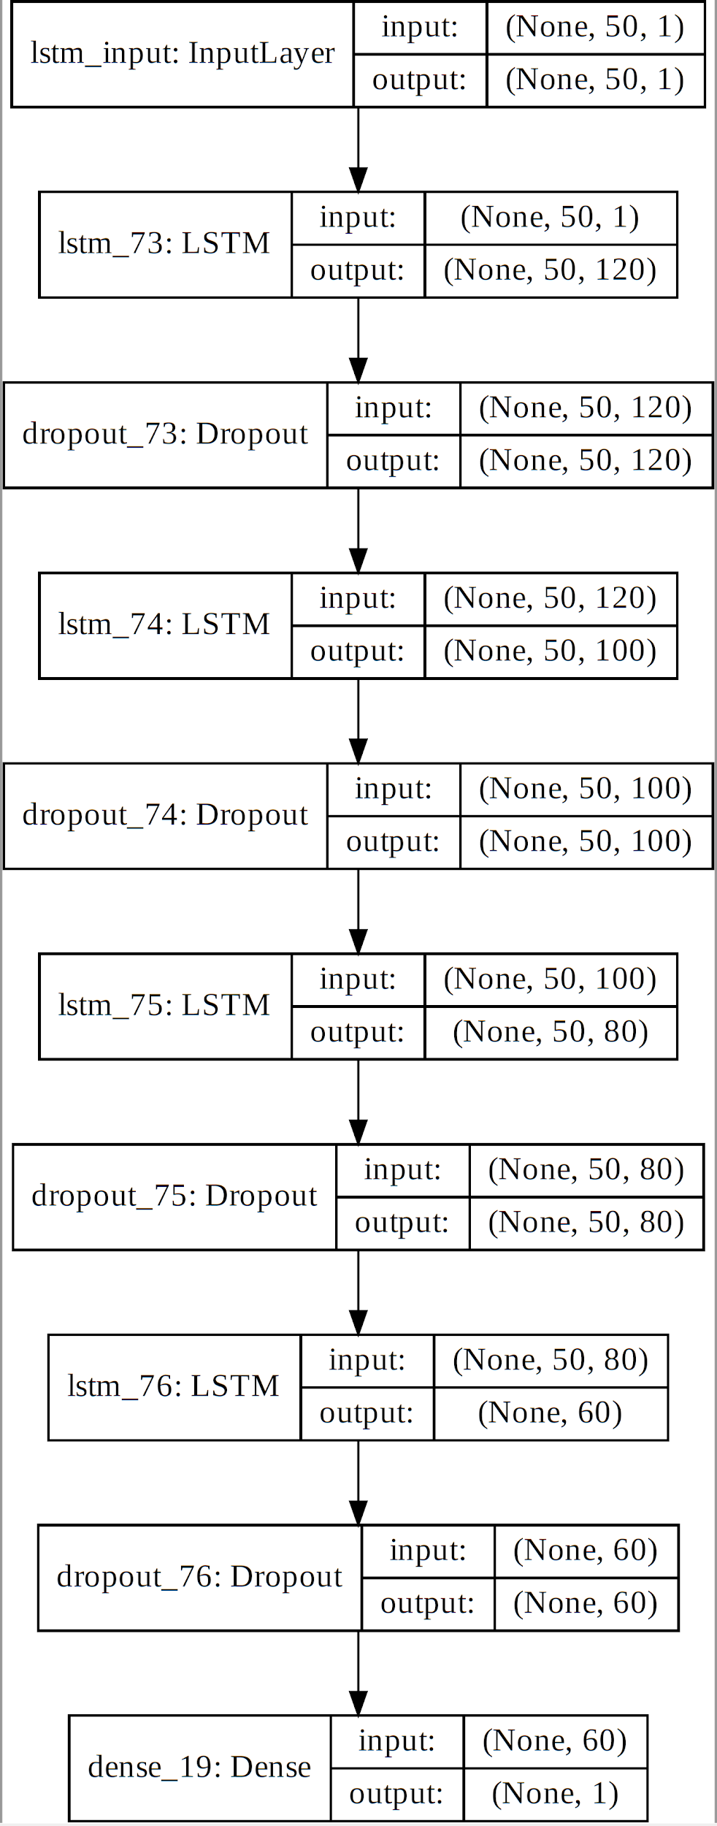
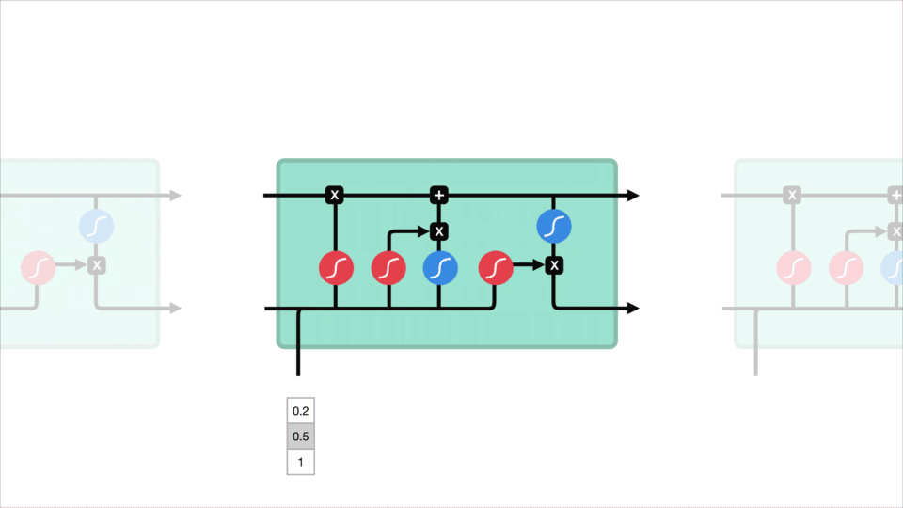
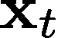
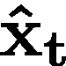
LSTM
We train a Multi-Stack LSTM with 4 LSTM layers and 4 Dropout layers followed by a Dense layer. It takes as input the stock price for the past 50 days and outputs the stock price prediction.
We train the LSTM using mean squared error (MSE) as our loss function and also use that for reporting our performance
Learning Rate | 0.005
Optimizer | Adam
Batch Size | 256
Epochs | 400
Window Length | 50
where is the actual stock price and is the predicted stock price

Slide 8
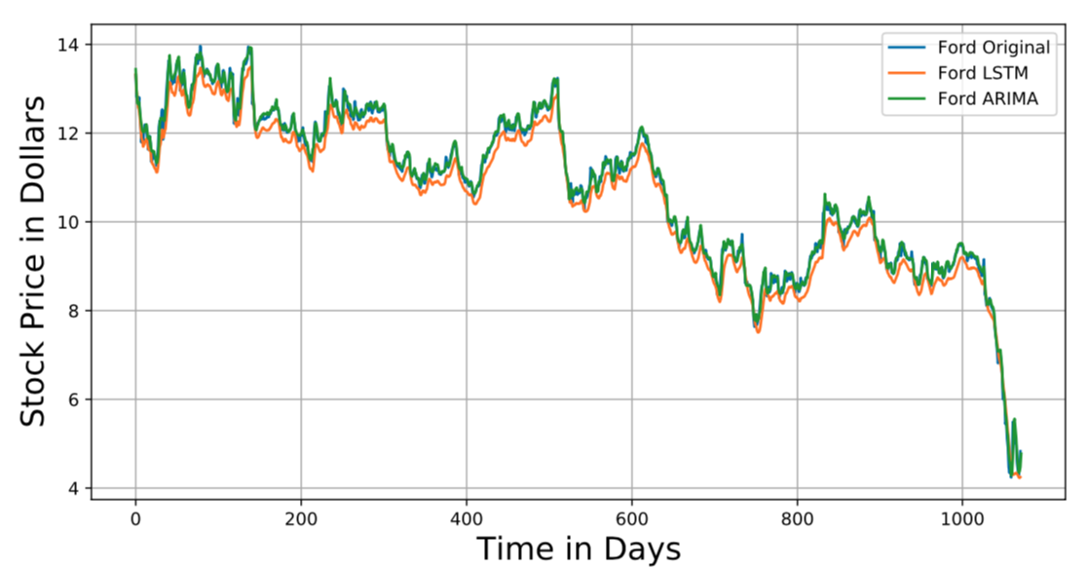
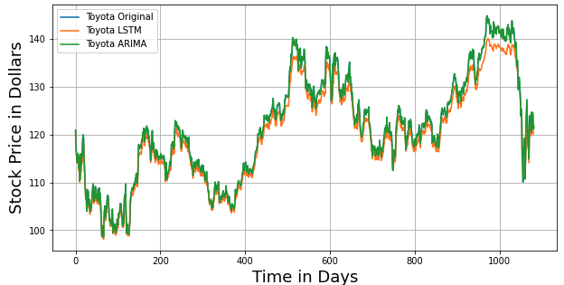
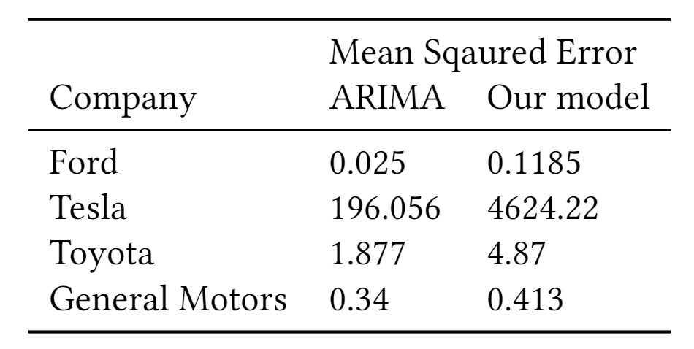
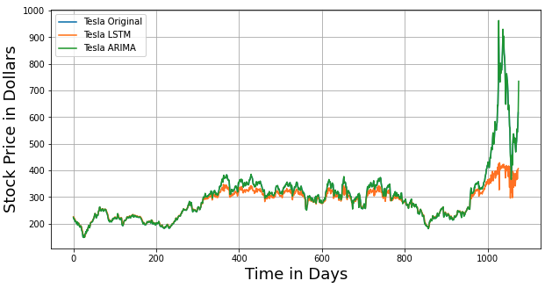
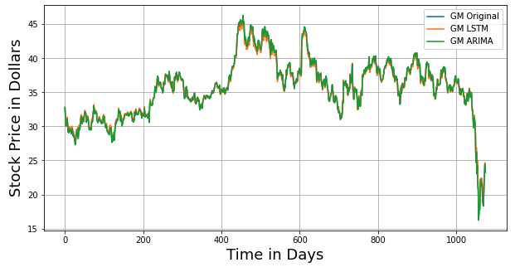
LSTM & ARIMA Results
ARIMA appears to fit the stock prices better than LSTM, but that does not mean it will maximize the profit
Notes:
Do mention that while their MSE is similar, the MSE is not an appropriate measure of performance. The profit earned is, and that is presented next.

Slide 9

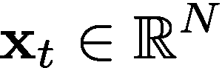
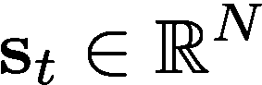
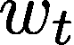
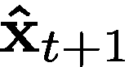
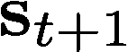
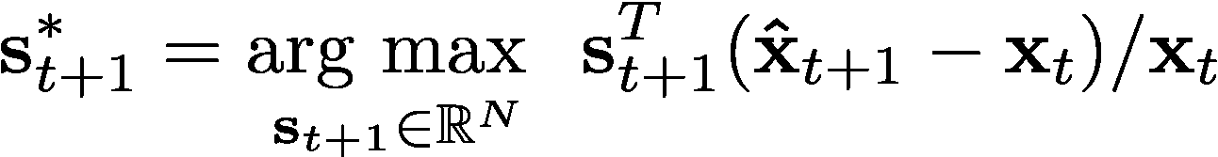
Portfolio Manager Bot : Formulation
N companies with stock price at time t of and number of shares in each company . Denote wealth not invested at time t as .
It is assumed that the investor is allowed to rebalance his portfolio on a daily basis.
The investor then utilizes the stock prediction to design a new portfolio, , that maximizes his percentage profit.
subject to
Notes:
y

Slide 10
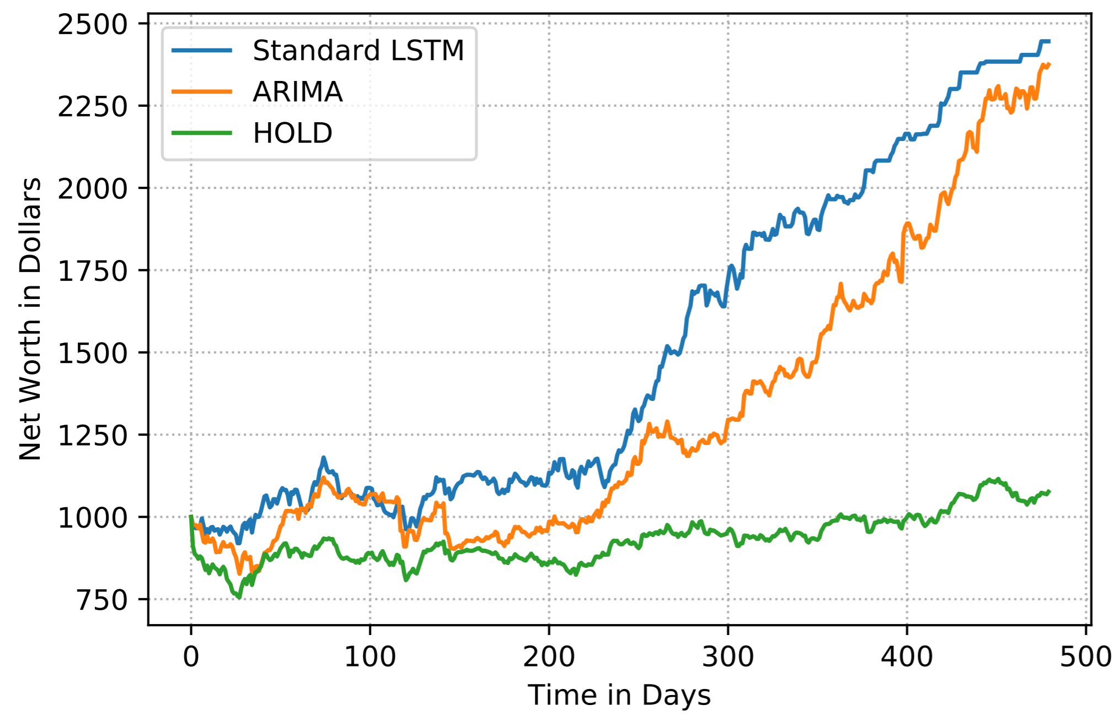
Portfolio Manager Bot : Results
We feed the LSTM and ARIMA predictions into the trading bot and compare it against a baseline that invests equally in all companies and does not rebalance .
The performance of LSTM and ARIMA is comparable

Slide 11
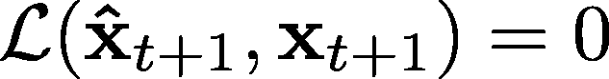
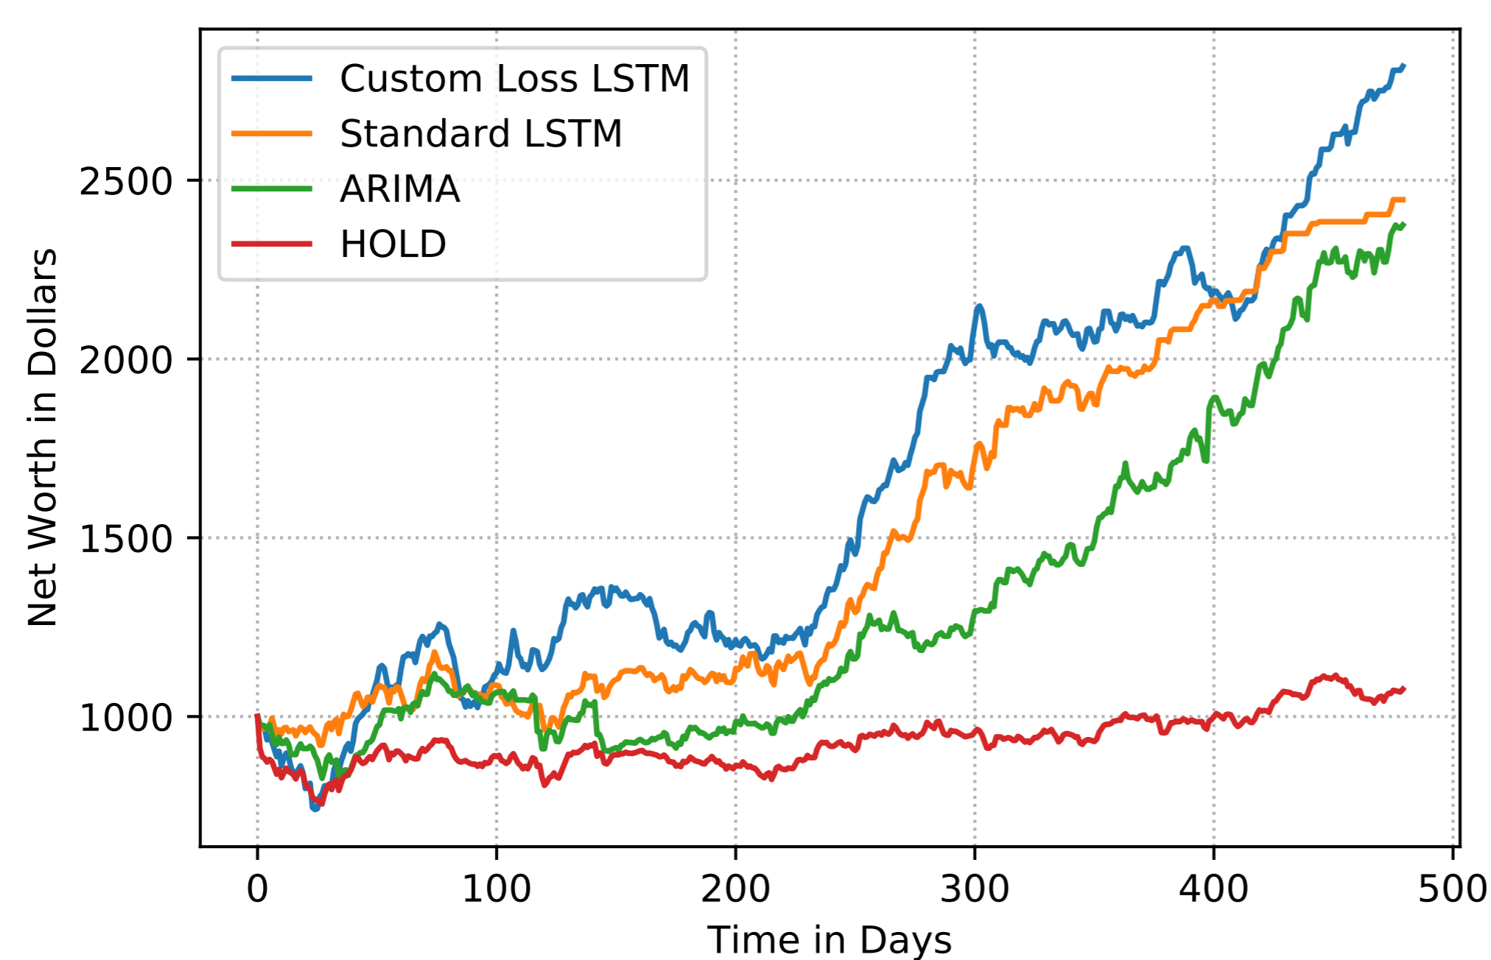
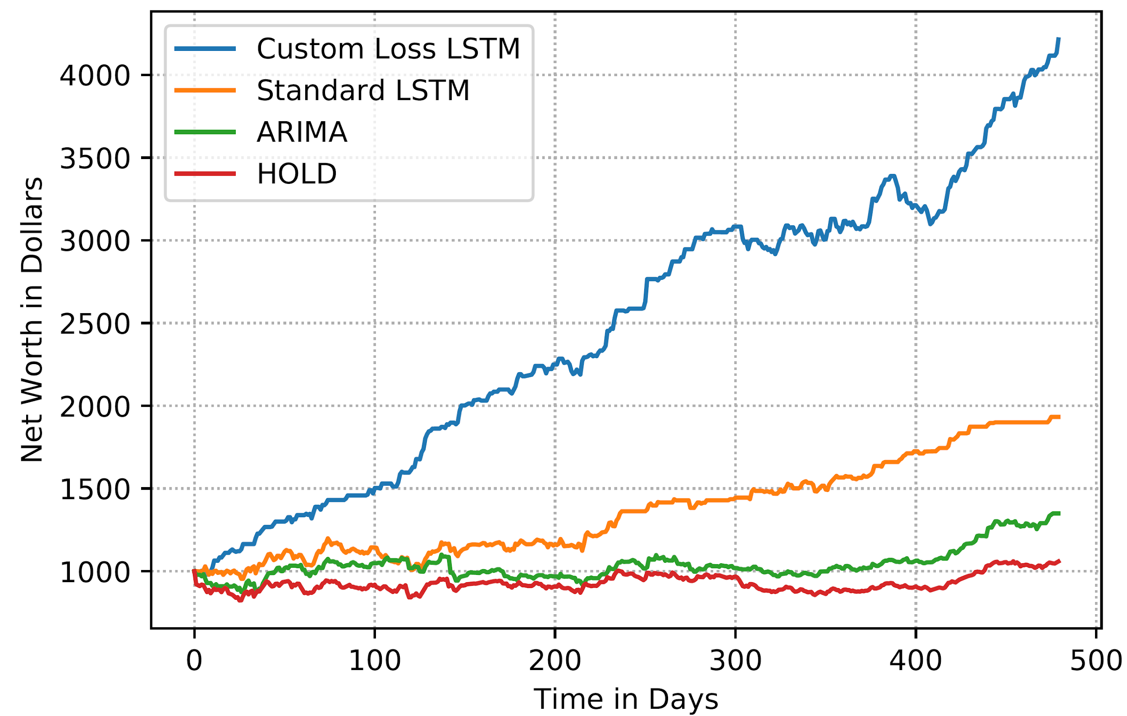
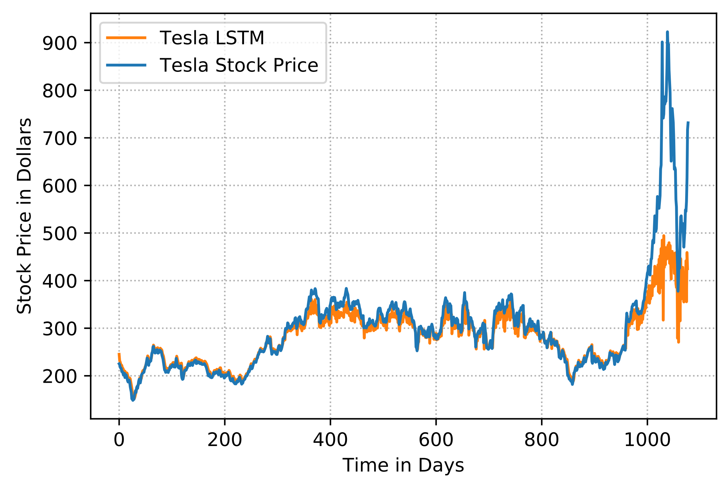
Custom Loss Function : Increases Profit
To maximize profit, it is crucial that when the stock price rises, the LSTM does not predict a fall. To penalize such wrong directions of movement, we modify our loss function and retrain the LSTM.
When
Else
Excluding Tesla

Slide 12
Extensions

Slide 13
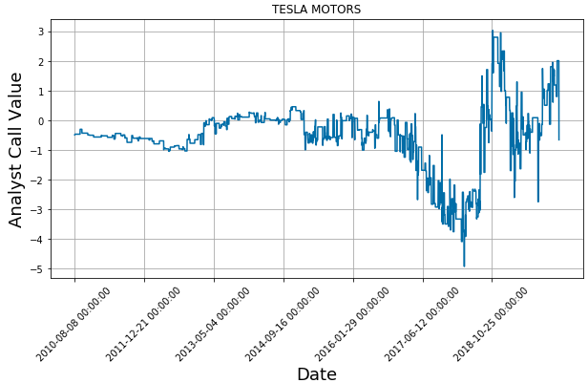
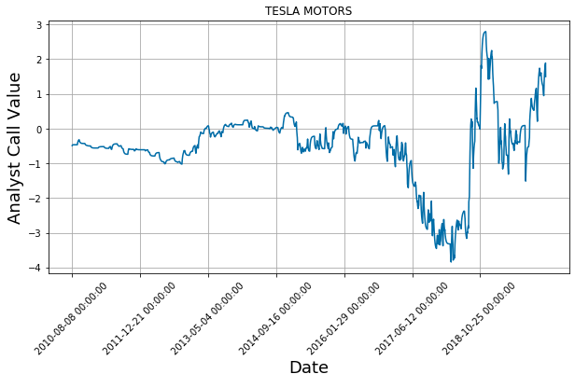
Extension 1a: Adding Analyst Call
Analyst calls are expert predictions for Earning Per Share (EPS) of a company and show weak correlation with the company’s stock price
They are reported every few days, however, and we needed to smoothen this data to denoise its predictions as shown on the right.
We decided to augment our stock price data with the analyst call data to see if it could improve the MSE in multi-step LSTM prediction.
Analyst Reports were collected from the IBES Database of Thomson Reuters.
Notes:
Tried different analyst calls for our prediction and selected only quarterly earnings per share because they exhibit a time lead with the actual EPS of the stock.
Reduced noise from divergent predictions by smoothing the data.
Analyst call numbers show only weak correlation with stock prices because stock prices are affected by multitude of factors
We expect multi stack LSTM to extract valuable information from such low-correlated factors.

Slide 14
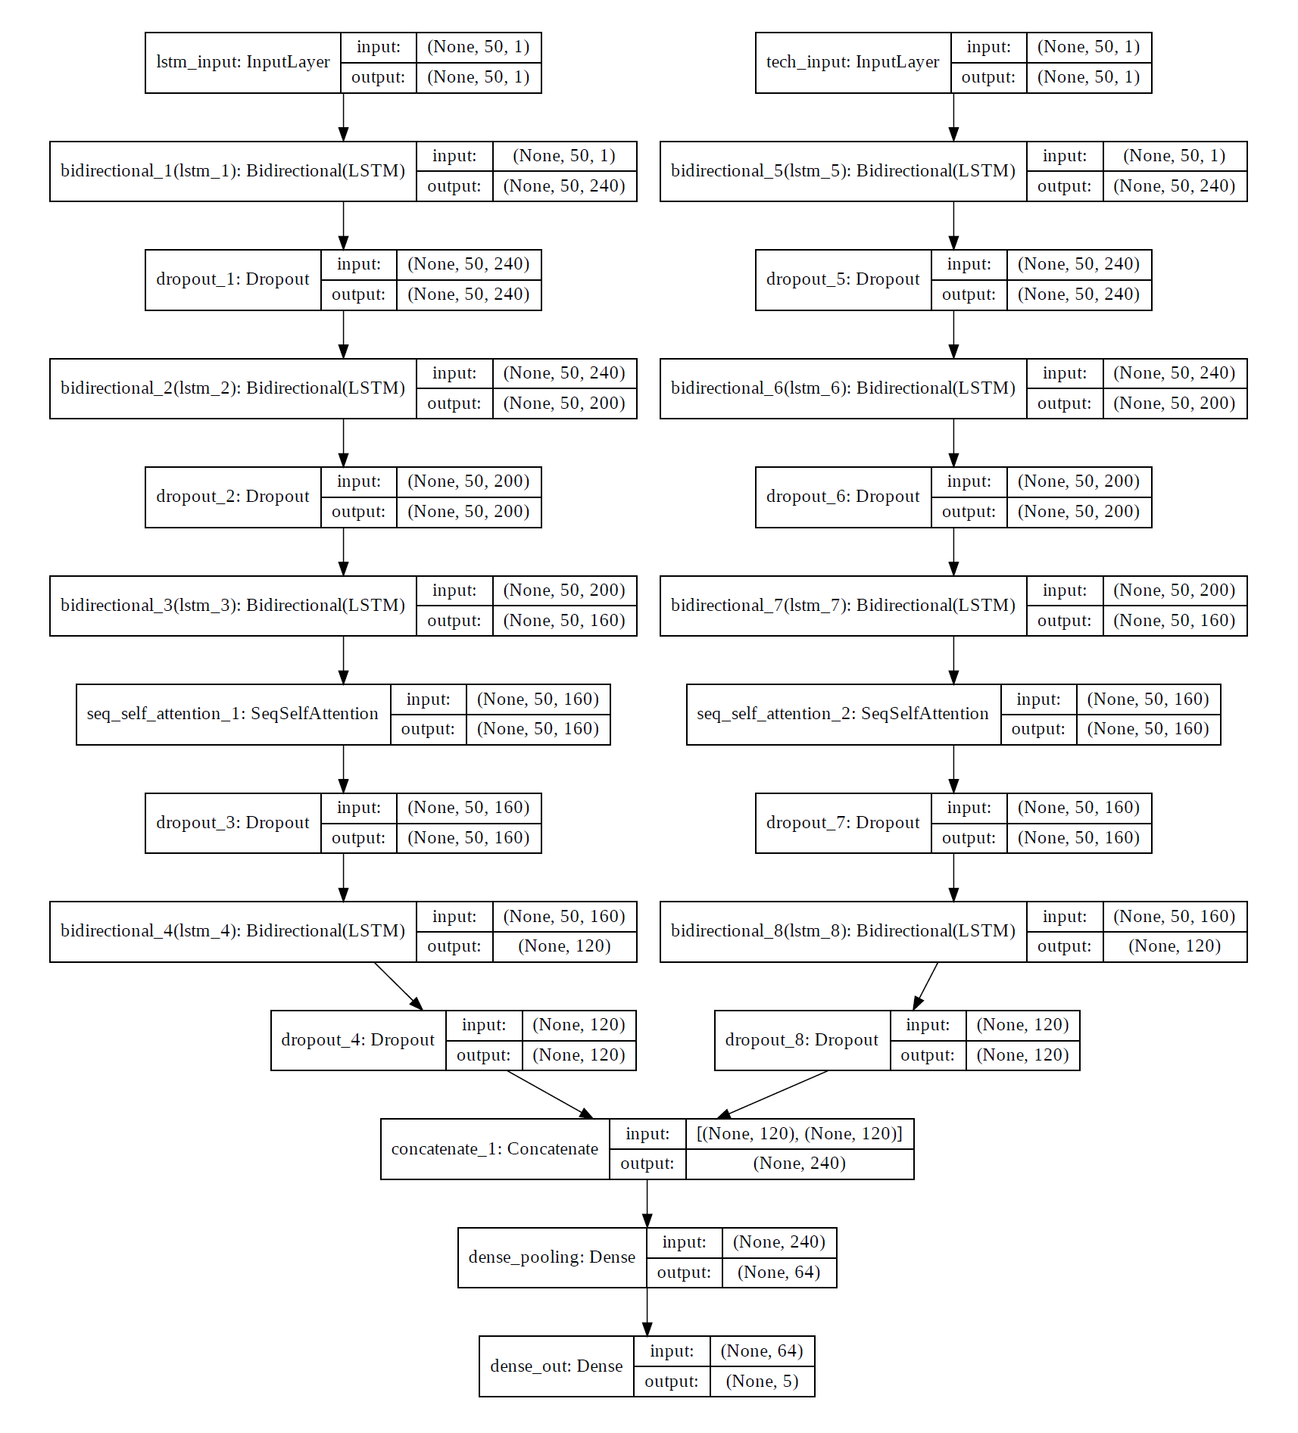
Extension 1b: Bidirectional LSTM with Attention
The analyst calls are passed through a separate LSTM as shown on the right
Bi-directional LSTMs enable us to fit the data better by incorporating past and future dependencies during training, while attention selectively chooses from all past inputs which one to weight more.
We hoped this would capture hidden trends in the data
We got a reduction in MSE using the Ford stock prices. However, it did not work well on other datasets
Could be due to an imbalance in number of parameters vs. number of data points

Slide 15
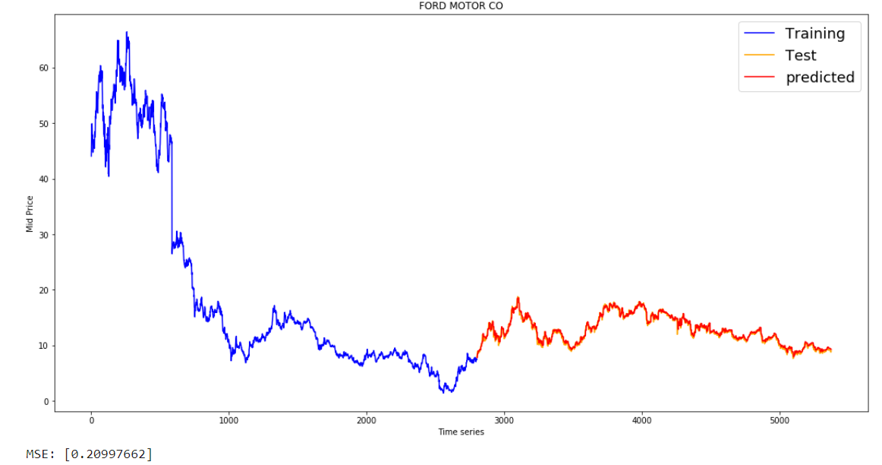
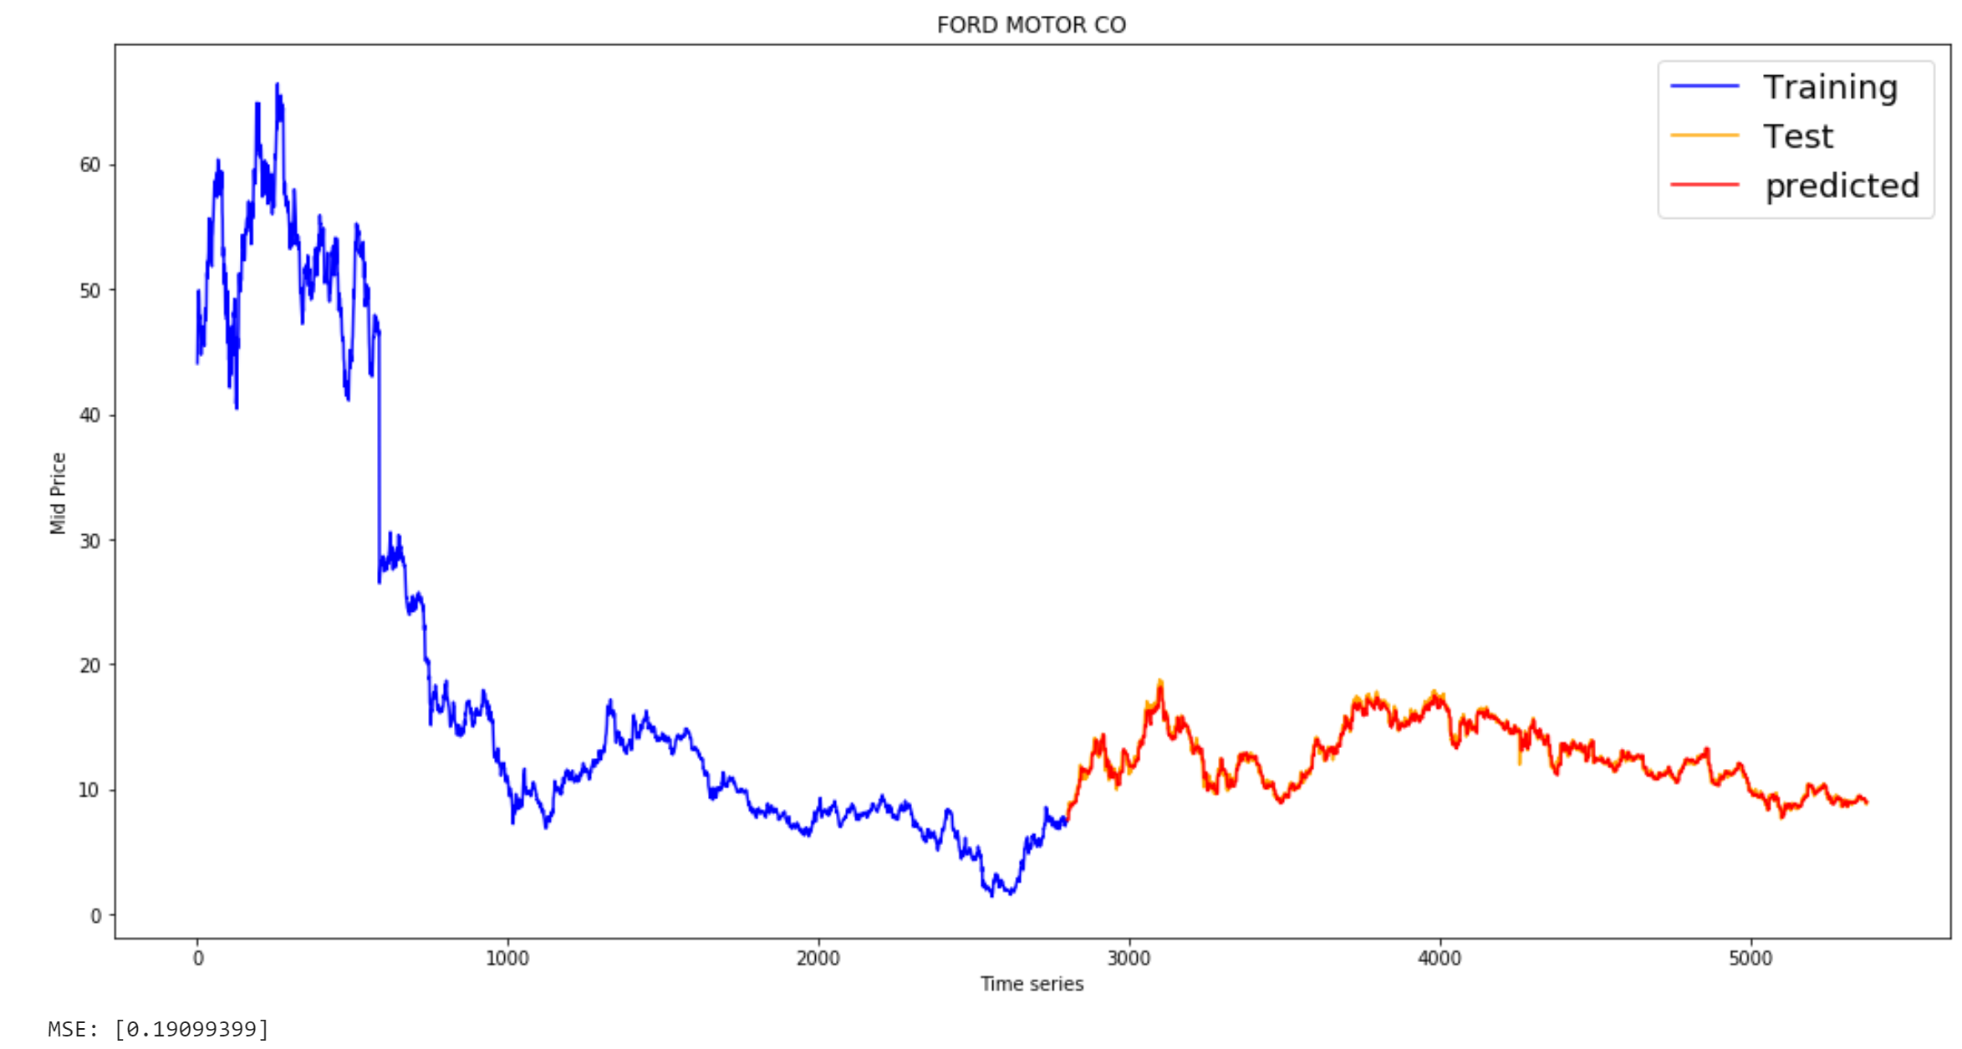
Extension 1b: Bidirectional LSTM with Attention
Adding Analyst Call
5 day Multi-step prediction using a single Multi-Stack LSTM
5 day Multi-step prediction using two Multi-Stack Bidirectional LSTMs with Attention
MSE : 0.2099
MSE : 0.1909
Additional of correlated indicators has potential to improve the performance, but it is highly data dependent.

Slide 16
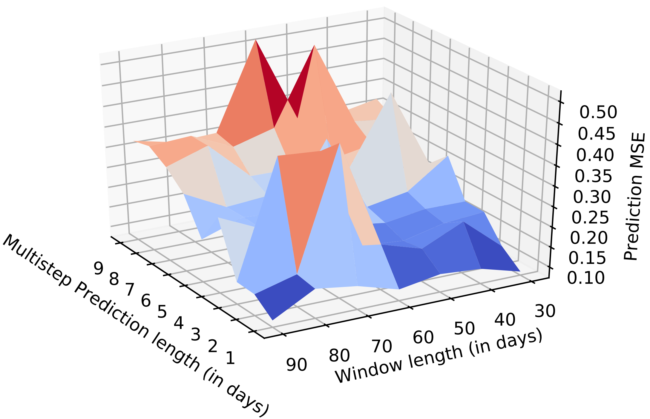
Extension 2: Varying training window & prediction length
We vary the number of past stock prices used for prediction from 30 to 90, and the number of days predicted by the LSTM from 1 to 9.
This is a data driven approach to finding the optimal hyperparameters for the LSTM, and the optimal frequency for portfolio rebalancing.
We can perform this for all companies, find the global minima and design our trading bot accordingly.
Notes:
Ford

Slide 17
Prior Work
Gaurav et al. (2019) exploited a deep FLANN (similar to a feedforward NN with time dependent weights) architecture and compared that with CNN.
Liu et al. (2019) used sparse autoencoders with 1-D residual convolutional networks to denoise the data. LSTMs were then used to predict the stock price. The average accuracy was reported using the mean absolute percent error (MAPE).
Li, Shen, and Zhu (2018) deployed an attention based multi input LSTM to predict stock prices.
In contrast, we attempt to modify the loss function with the direct motive of maximizing the profit, and design a trading bot that exploits prediction from multiple LSTMs to perform portfolio optimization.
Notes:
FNN: Deep Functional link artificial neural network
However, apart from stock price prediction which was done based on .
They have reported accuracies for prediction of stock price in their testing data in a range of 0.3-0.867.

Slide 18
Conclusion and Future Directions
ARIMA and LSTM have comparable accuracy for stock price predictions on majority of the data
LSTM fares poorly on highly volatile stocks, and ARIMA outperforms it.
However LSTMs have a more flexible training procedure that can be modified to indirectly maximize the profit.
Augmenting Weakly correlated data, along with hyperparameter tuning, can be used to optimize LSTM performance.
As a future direction, we can utilize sparse autoencoders with 1-D residual convolutional networks to denoise the data.

Slide 19
References
Hyndman, Rob J., and George Athanasopoulos. Forecasting: principles and practice. OTexts, 2018.
Kim, Taewook, and Ha Young Kim. "Forecasting stock prices with a feature fusion LSTM-CNN model using different representations of the same data." PloS one 14.2 (2019).
Kingma, Diederik P., and Jimmy Ba. "Adam: A method for stochastic optimization." arXiv preprint arXiv:1412.6980 (2014).
Li, Hao, Yanyan Shen, and Yanmin Zhu. "Stock price prediction using attention-based multi-input LSTM." Asian Conference on Machine Learning. 2018.
Liu, Jialin, et al. "Stock Prices Prediction using Deep Learning Models." arXiv preprint arXiv:1909.12227 (2019).

Slide 20


Slide 21
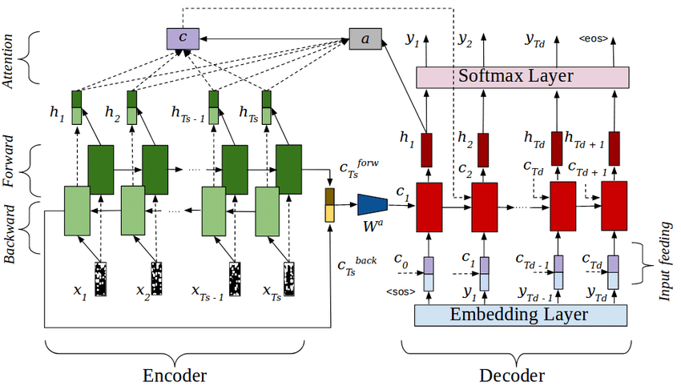
Bidirectional LSTM with Attention

